Slide 1
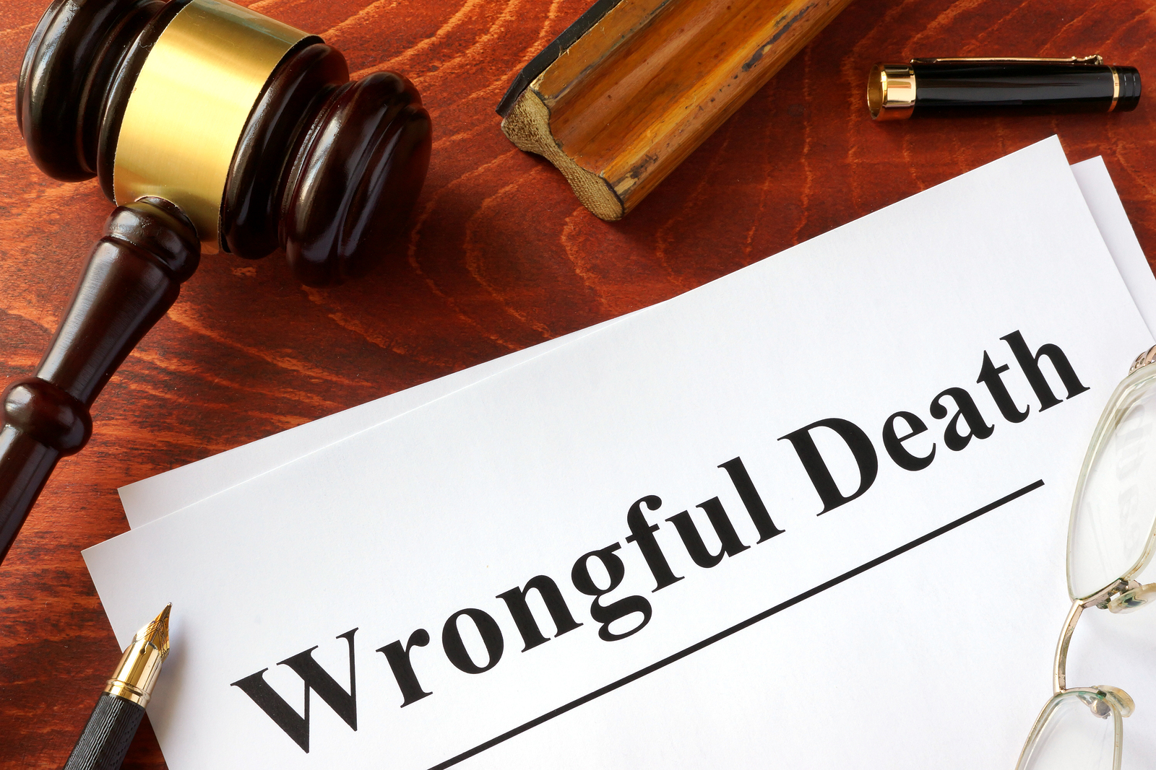
Wrongful Death Lawsuit
If you or your loved one was suffered from an injury or death due to someone's negligent actions, then you need an experienced attorney to fight for your rights.

Slide 2
Types of Wrongful Death Accidents
1. Premises Liability
2. Automobile Accidents
3. Medical Malpractice
4. Product Liability
5. Elder Abuse/Nursing Home Abuse

Slide 3
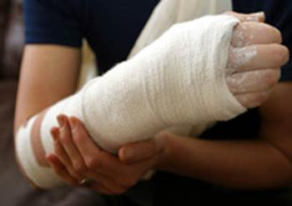
Premises Liability
Premises liability law pertains to injuries, including slip and fall injuries, caused by unsafe premises. The law requires that property owners maintain the safety of their property. When they fail to do so and their failure causes injury to a visitor, the property owner can be held liable for the injury.

Slide 4
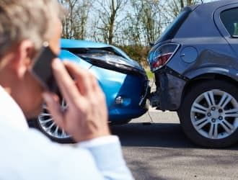
Automobile Accidents
It happens when you or your loved one has died in a Car, Truck, Motorcycle, and Pedesterain accident due to recklessness and carelessness of a driver. Other Cause of road accident is Defective Roads, if there is any problem in construction of road you can sue them.

Slide 5
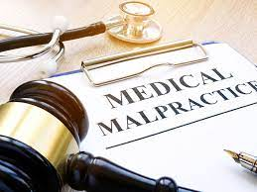
It Happens when you or someone you love has suffered a severe personal injury or if you have lost a member of your family to wrongful death due to a healthcare provider’s negligence. Surgical Errors and Diagnosis Error are some of the examples of Medical Malpractice.
Medical Malpractice

Slide 6
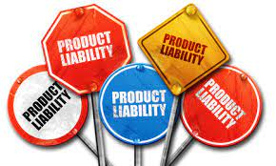
Product Liability
Any or all parties involved in the design, manufacture, and marketing of a defective product may be held responsible for whatever injuries result from the use of the product. These parties must take reasonable measures to ensure that a product does not pose any unforeseeable hazards to consumers when used for its intended purpose.

Slide 7
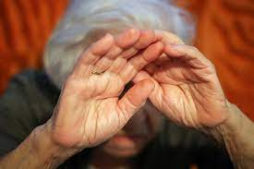
Nursing Home or elder Abuse
In nursing home abuse or elder abuse and neglect cases, it occurs when the elderly patient dies as a result of neglect, abuse or inadequate treatment or care. If your loved one has died due to negligence of nursing home abuse you can sue that elder care facility.

Slide 8
Contact Us
www.yorklawcorp.com
info@yorklawcorp.com
800-939-1832

